Slide 1

SMART HOME
Submitted by : Omar Khaled El Baz

Slide 2
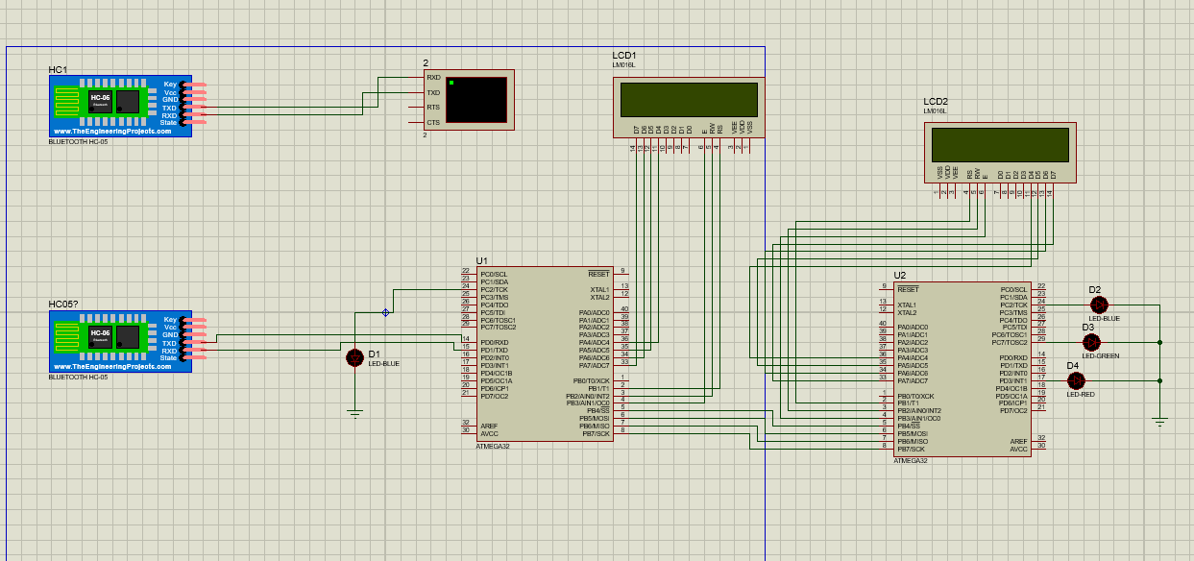
Introduction
This project is an implantation of a prototype for smart home as we control our actuators here which is leds by a Bluetooth module connected to the master controller which sends a signal corresponding to the initial signal sent to the master the signal sent from the master to the slave is sent by SPI communication protocol the slave process the signal and act upon this signal to which actuator should work
NOTE: the second Bluetooth module is used as the mobile for simmulation

Slide 3
SID
mobile
Signal
Battery VCC
Battery
Bluetooth Module
Battery Ground
Atmega VCC
Atmega32
MASTER
Atmega32
SLAVE
LED
LCD 16*2
LCD 16*2

Slide 4
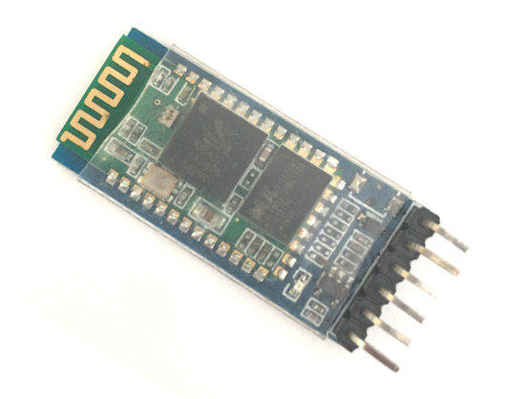
Hardware Description
Bluetooth Module
Our Bluetooth module is hc-05 as shown in the figure this Bluetooth module operates at 5 v
and a frequency of 2.4 GHZ

Slide 5
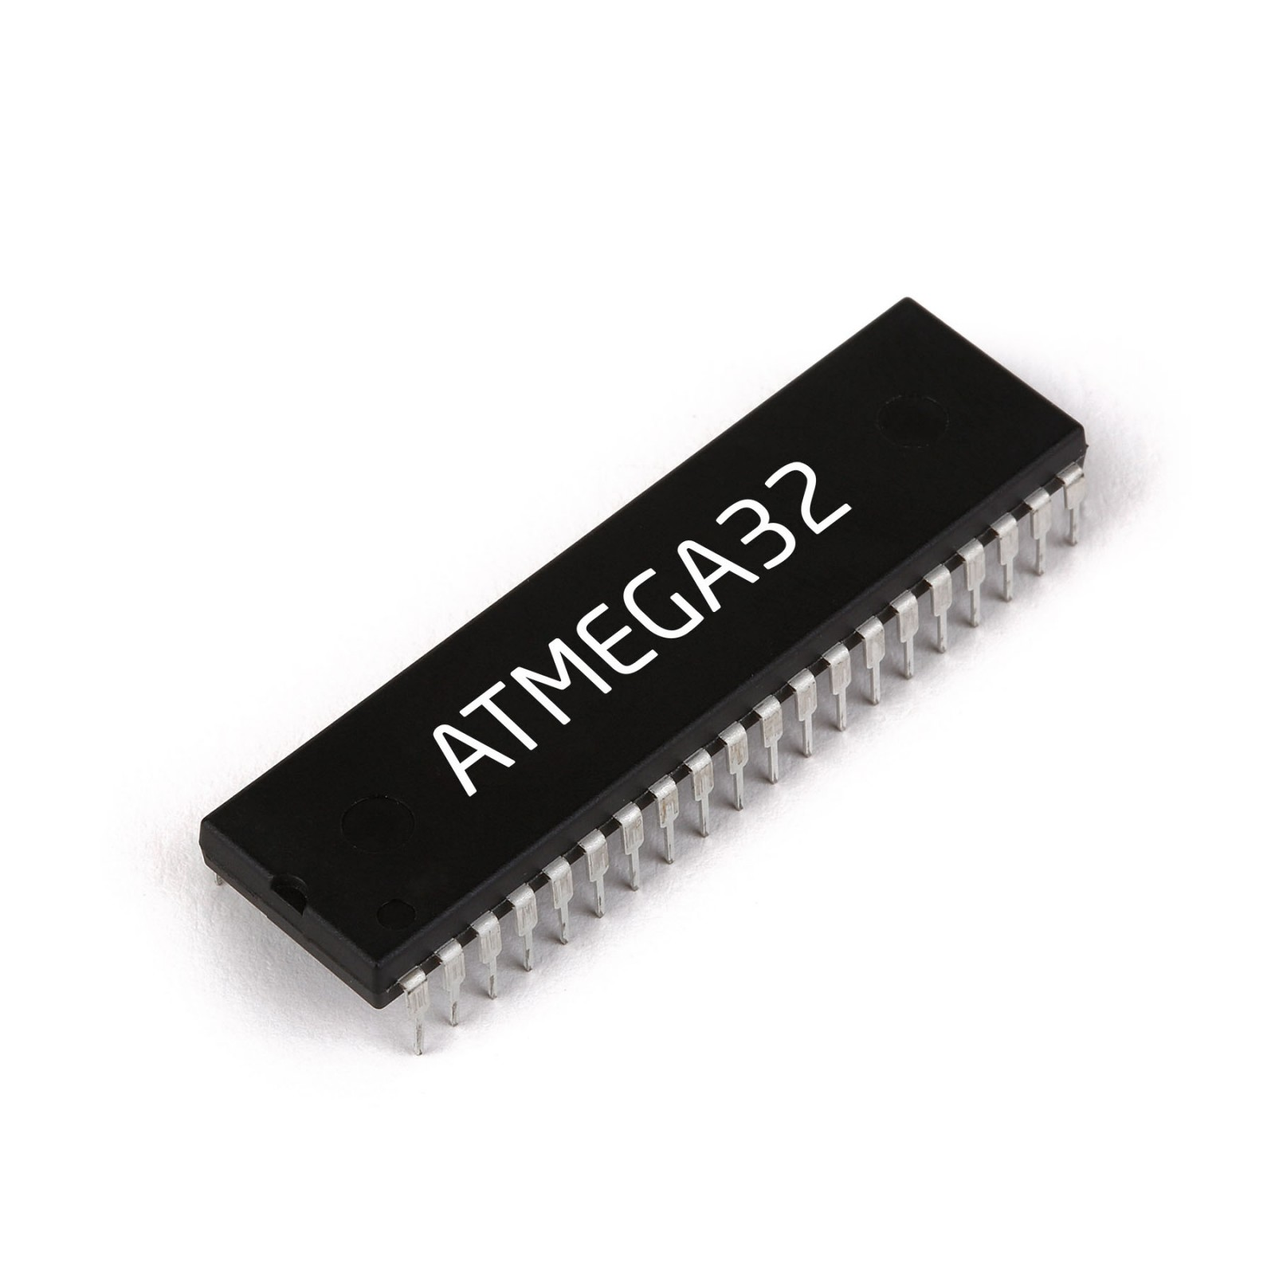
ATmega32
– Two 8-bit Timer/Counters with Separate Prescalers and Compare Modes
– One 16-bit Timer/Counter with Separate Prescaler, Compare Mode, and Capture Mode
– Real Time Counter with Separate Oscillator
– Four PWM Channels
– 8-channel, 10-bit ADC 8 Single-ended Channels 7 Differential Channels in TQFP Package Only 2 Differential Channels with Programmable Gain at 1x, 10x, or 200x
– Byte-oriented Two-wire Serial Interface
– Programmable Serial USART
– Master/Slave SPI Serial Interface
– Programmable Watchdog Timer with Separate On-chip Oscillator
– On-chip Analog Comparator

Slide 6
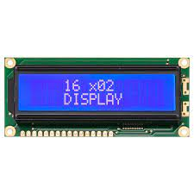
Lcd 16*2
Operating Voltage is 4.7V to 5.3V
Current consumption is 1mA without backlight
Alphanumeric LCD display module, meaning can display alphabets and numbers
Consists of two rows and each row can print 16 characters.
Each character is build by a 5×8 pixel box
Can work on both 8-bit and 4-bit mode
It can also display any custom generated characters

Slide 7
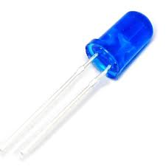
LED
Basic blue leds

Slide 8
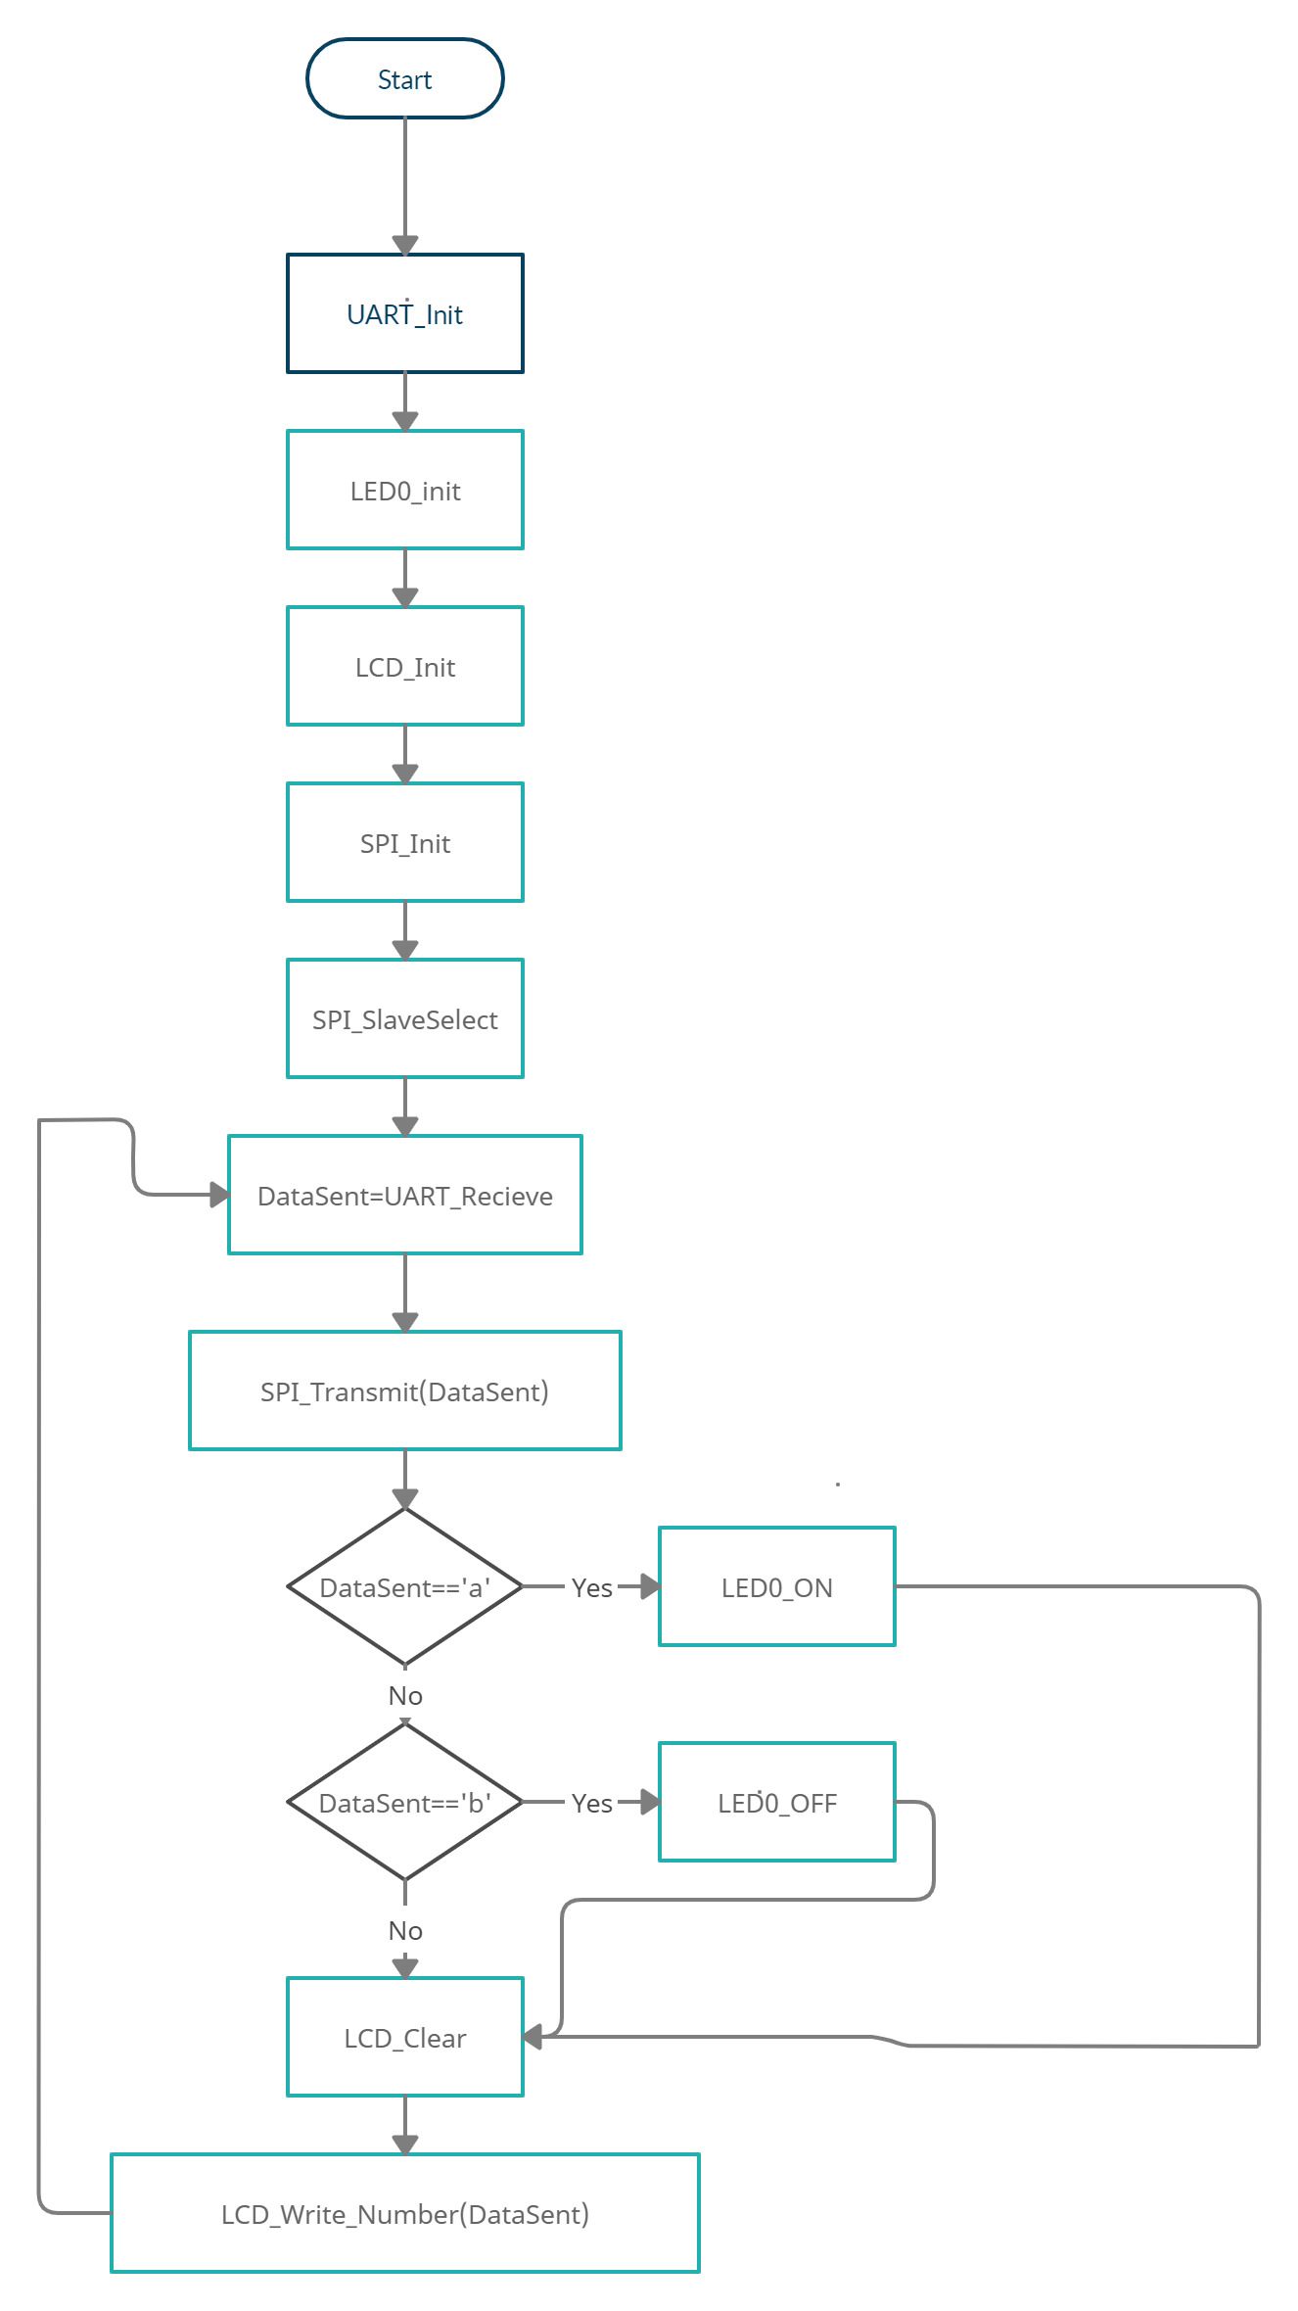
Software Master Flowchart

Slide 9
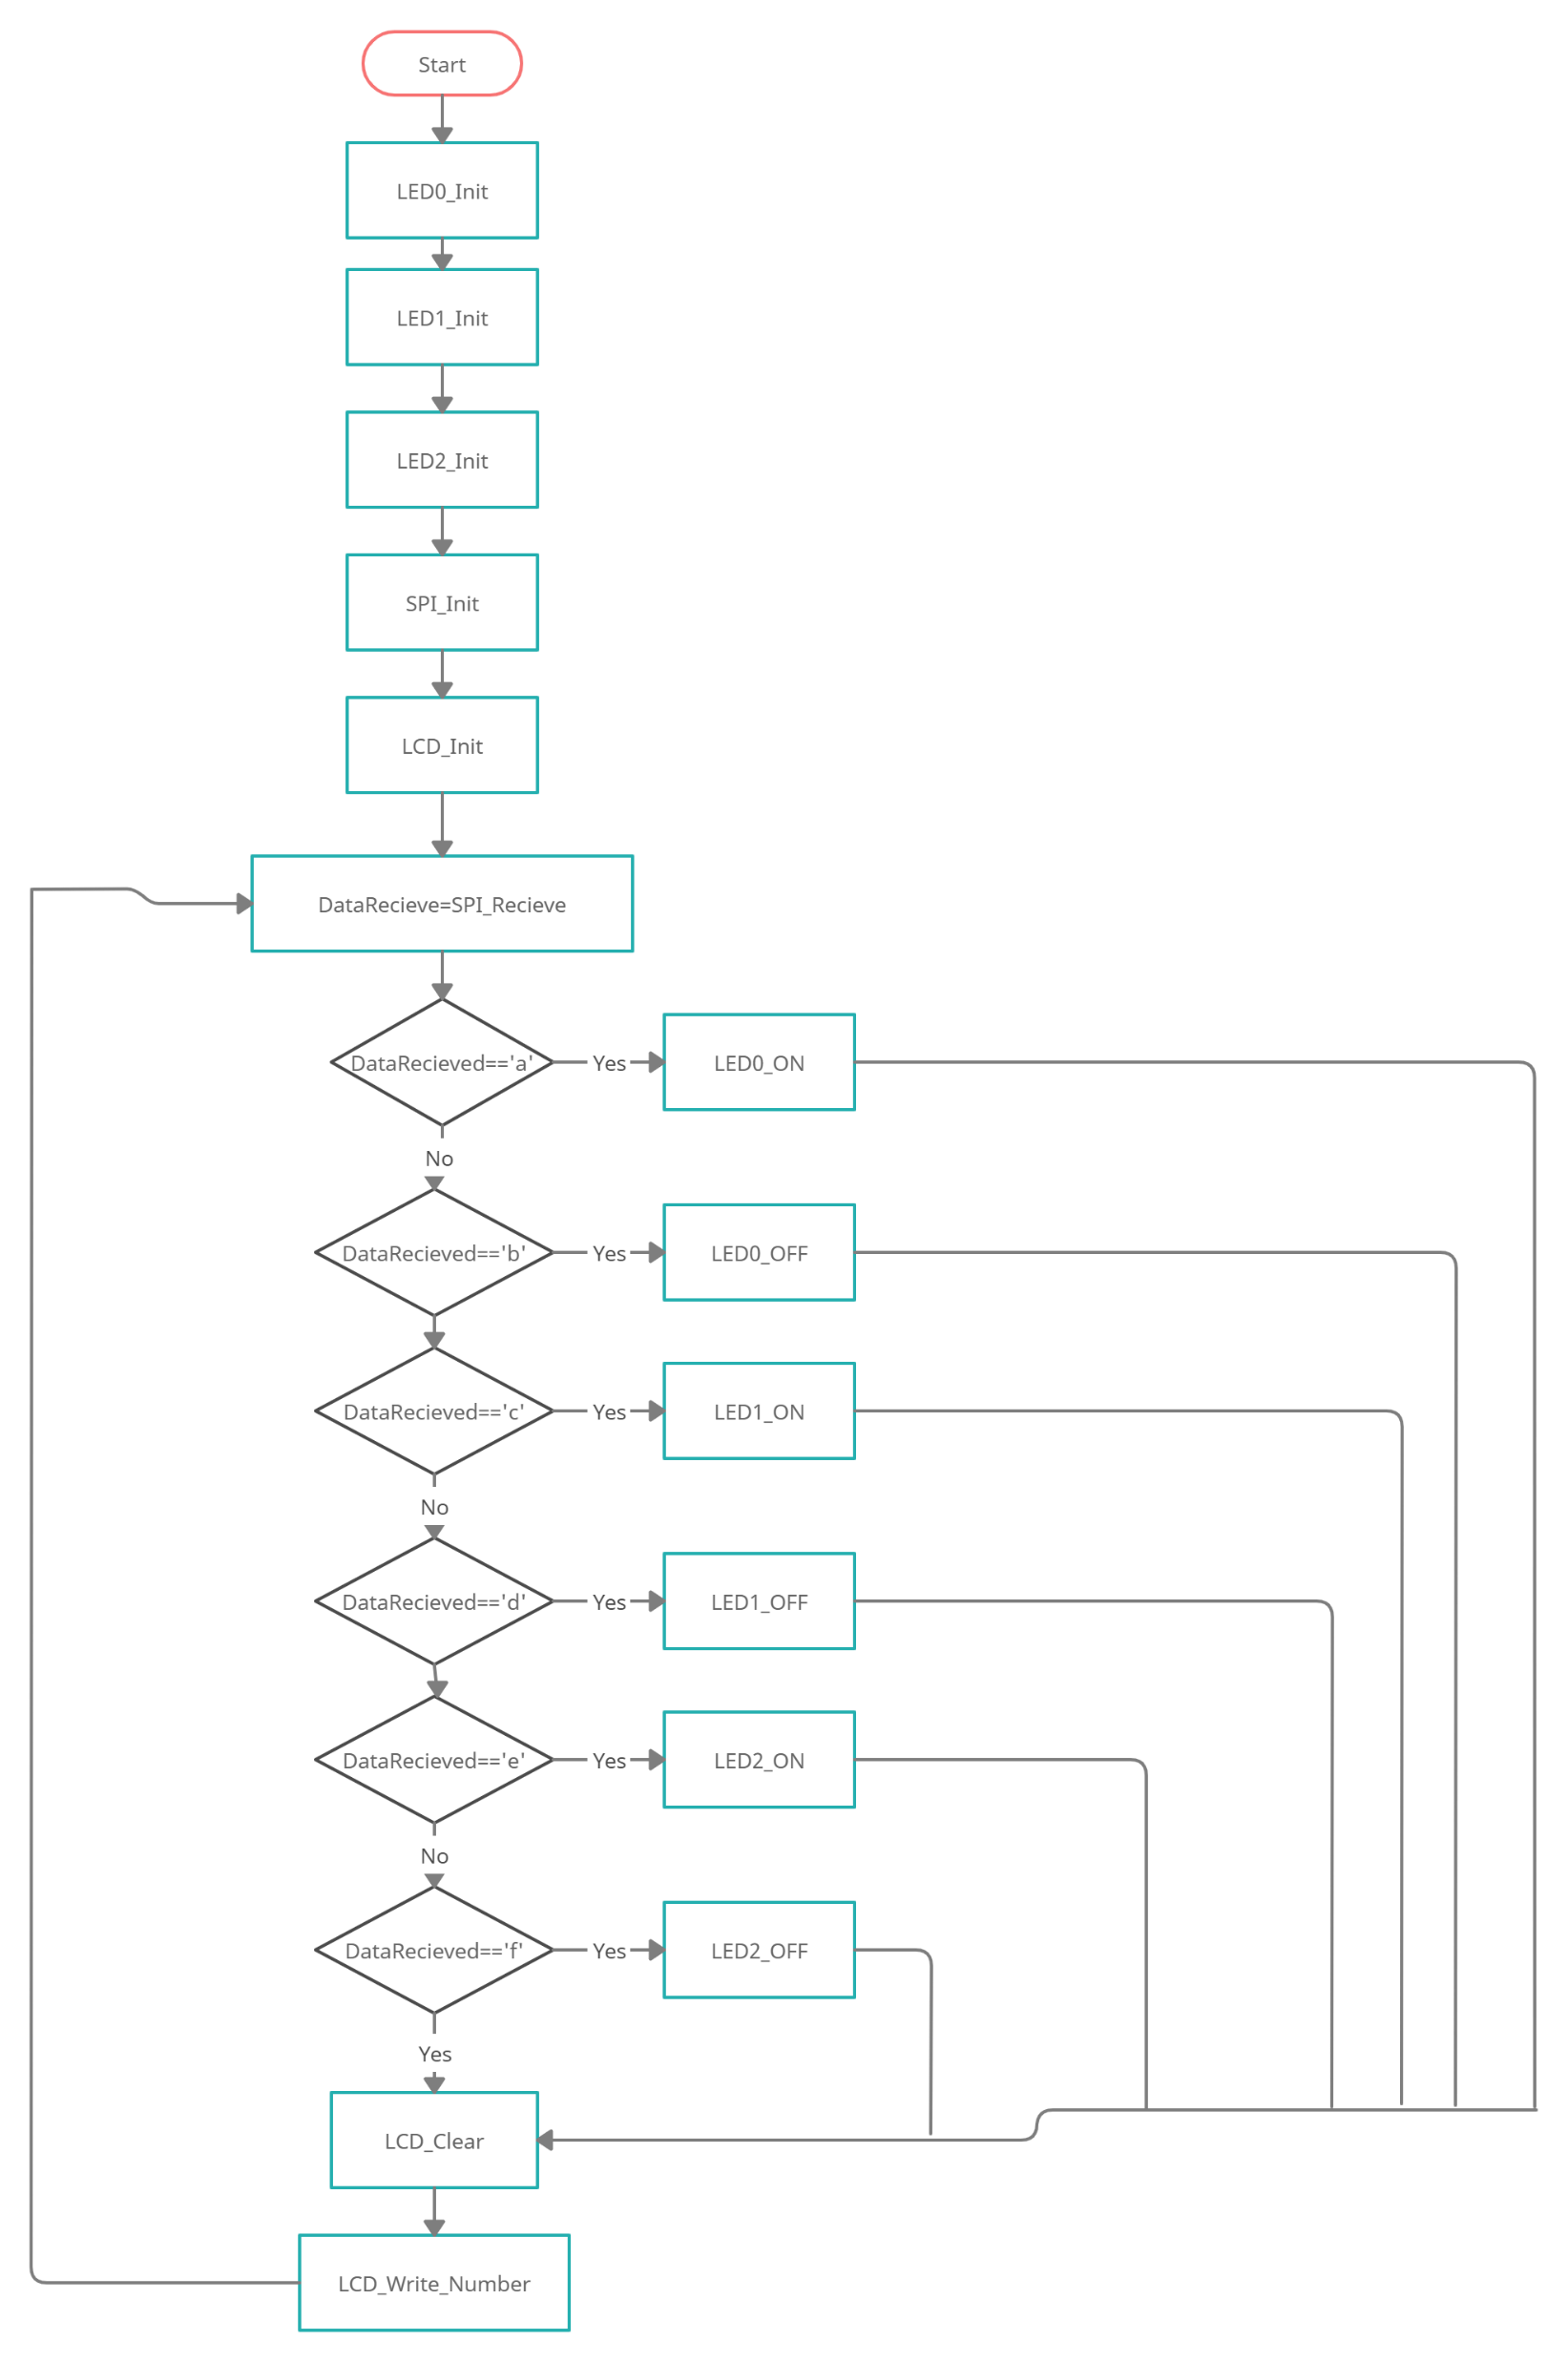
Software Slave Flowchart

Slide 10
Functions Description
LED0_Initialize
This function defines th direction of led0 which is connected to pin 2 in port c
LED_ON
Change the pin value to HIGH
LED_OFF change the pin value to LOW
LCD_Init
This function define the direction for data and commands pins and initialize lcd in 4 bit mode and clear display

Slide 11
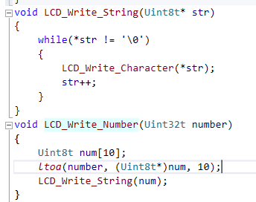
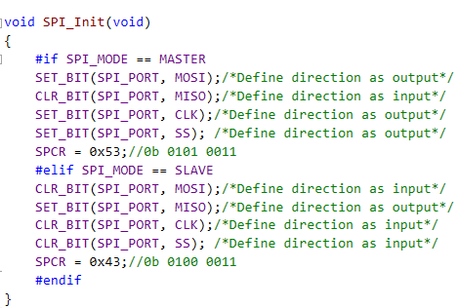

Lcd_write_number
Convert llong data type to a string and writes it as a string
Lcd_write_string
The function loops the string and print each character until it reaches null
SPI_init
This function defines pins directions for spi and initialize spi as initialize sck frequency as Fosc/128 and initializng CPHA and CPOL as shown in the figures and select that this controller is in master mode and enables spi

Slide 12
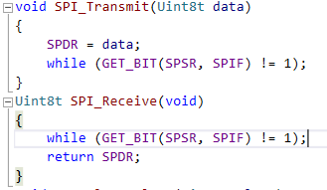
SPI_Transmit
Puts data in SPDR and waits until the flag is on
SPI_Recieve
Waits until the flag is on and returns data in SPDR

Slide 13
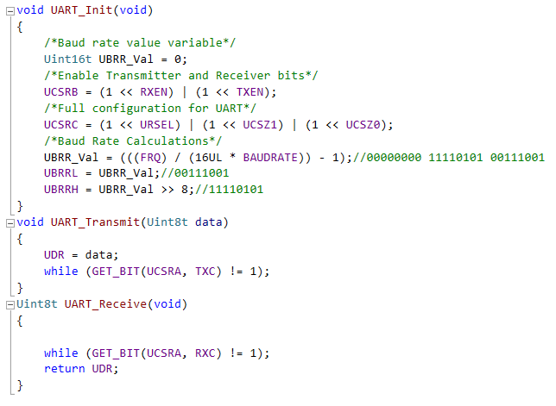
UART_Init
Enables receiver and transmitter pins and initialize UART in synchronous mode and 8 bit mode and define the bauderate
UART_Transmit
Puts the data in UDR and waits until the TXC flag is on
UART_Recieve
Waits until the RXC flag is on and returns the data from UDR

Slide 14
THANK YOU

